Slide 1


VIDEO CALLING WEBSITE
Presented By:
Kolisetty Aashrita(R21EJ061)
L Charan Sai Reddy(R21EJ062)
M.Keshava Kalyan(R21EJ064)
J Hima Sree(R21EJ107)
Btech in CSIT-3rd year/6th sem
Date:26/03/2024
Under the Guidance: Prof Kasi Vishwanath

Slide 2
CONTENTS
ABSTRACT
INTRODUCTION
LITERATURE SURVEY
PROBLEM FORMULATION
METHODOLOGY
RESULTS
REFERENCES

Slide 3

ABSTRACT
In today's interconnected world, effective communication is paramount, especially when physical distances separate individuals. The advent of web-based technologies has revolutionized how we connect, and video calling has become an integral part of this digital landscape. This project aims to develop a user-friendly video calling website using modern web development techniques.
The proposed platform will offer seamless real-time communication through high-quality video and audio transmission, facilitating interactions between individuals regardless of their geographic locations.
Key features of the website include user authentication, contact management, and intuitive interface design.

Slide 4
INTRODUCTION
Digital connectivity has transformed modern life, making seamless communication across distances essential.
Video calling is now a cornerstone of personal and professional interactions.
With the rise of web-based technologies, the convenience and accessibility of video calling have reached new heights.
Developing a user-friendly and robust video calling website using cutting-edge web development techniques is a compelling endeavor.
This project aims to deliver a solution that:
Facilitates real-time communication
Prioritizes user experience, security, and accessibility
Transcends geographical barriers and enables face-to-face conversations from the comfort of devices.

Slide 5

SOFTWARE USED
Video SDKs often provide tools for tasks such as video streaming, recording, playback, editing, and sometimes even real-time video communication. Real-time video infrastructure for every developer Real-time audio video SDKs offer complete flexibility, scalability, and control, making it effortless to integrate audio-video conferencing and live streaming into web and mobile apps

Slide 6
Video SDKs are commonly used in a wide range of applications, including:
Live Streaming Platforms
Video Conferencing and Communication
Video Analytics
Video Editing and Processing
Augmented Reality (AR) and Virtual Reality (VR)
When choosing a video SDK for a particular project, developers consider factors such as ease of integration, platform support (e.g., iOS, Android, web), scalability, performance, pricing, and available features. Popular video SDKs include Twilio Video, Agora SDK, Vonage (formerly TokBox), Zoom SDK, and many others. Each SDK may have its own strengths and weaknesses, so it's essential to evaluate them based on your project requirements and goals.

Slide 7
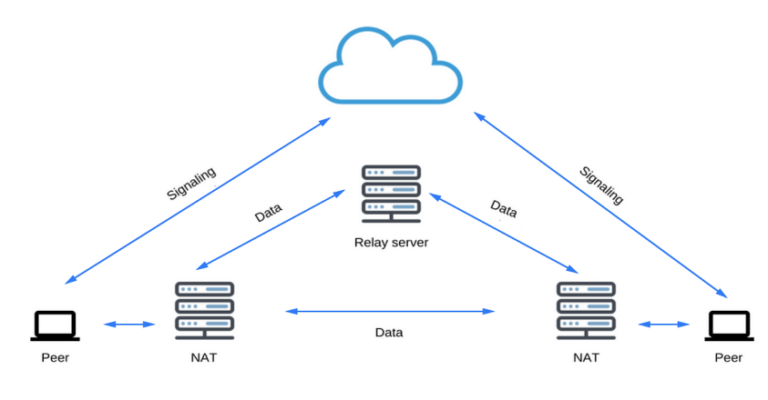
LITERATURE SURVEY
Real-time Communication with WebRTC: Peer-to-Peer in the Browser (2014) by Salvatore Loreto and Simon Pietro Romano
Explores WebRTC technology, architecture, capabilities, and practical applications
Discusses underlying protocols and APIs for establishing peer-to-peer connections within web browsers
Building Scalable WebRTC Infrastructure (2017) by Varun Singh
Focuses on scalability challenges in WebRTC-based applications
Presents strategies for deploying and managing WebRTC servers to support large-scale video calling services
Addresses issues such as load balancing, signalling server architecture, and media relay mechanisms

Slide 8
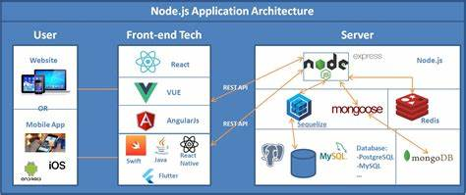
3. Web Development with Node and Express (2019) by Ethan Brown
Provides a comprehensive guide to web development using Node.js and Express.js
Covers topics such as routing, middleware, database integration, and authentication
Enables the creation of scalable and performant server-side solutions for real-time communication features

Slide 9
4. HTML5 and CSS3: Develop with Tomorrow's Standards Today (2014) by Brian P. Hogan
Explores HTML5 and CSS3, the building blocks of modern web design and development
Delves into advanced techniques for creating responsive layouts, implementing multimedia elements, and enhancing user interfaces
Serves as a valuable resource for mastering frontend web development skills
5. Security Engineering (2008) by Ross J. Anderson
Provides a comprehensive overview of principles, methodologies, and best practices for designing secure systems
Discusses essential topics such as encryption, authentication, access control, and threat modeling
Highly relevant to implementing robust security measures in a video calling website

Slide 10
PROBLEM FORMULATION
User Experience Enhancement
Address usability issues, such as complex interfaces, poor compatibility, and lack of intuitive features
Improve user experience for smooth navigation, clear communication controls, and compatibility across devices and browsers
Privacy and Security Concerns
Implement robust encryption protocols and privacy features
Safeguard user data and ensure confidentiality during video calls
Reliability and Stability
Develop mechanisms to enhance stability and reliability
Optimize network protocols and error handling to minimize technical glitches such as dropped calls, audio/video lag, or connection quality issues
Scalability
Implement scalable architecture and efficient resource allocation strategies
Support a growing user base without compromising performance

Slide 11
5. Accessibility
Ensure inclusivity and accessibility for users with diverse needs, including those with disabilities
6. Integration and Interoperability
Facilitate interoperability with third-party services through APIs and integration capabilities
7. Cost-Efficiency
Balance development costs with desired feature set and performance standards
Maximize value proposition while minimizing overhead costs through cost-effective development methodologies and open-source technologies

Slide 12
METHODOLOGY
1.Requirement Analysis:
Gather requirements from stakeholders and potential users regarding features, functionality, and usability expectations.
Conduct market research to understand user preferences, competitor offerings, and industry trends in video calling technology.
2.Conceptualization and Planning:
Define the scope of the project, including target audience, primary features, and technical requirements.
Create wireframes and prototypes to visualize the user interface and workflow of the video calling website.
Develop a project plan outlining timelines, milestones, resource allocation, and budget considerations.

Slide 13
3.Technology Selection:
Choose appropriate web development technologies and frameworks based on project requirements, scalability needs, and developer expertise.
Consider using HTML5, CSS3, JavaScript for frontend development, and backend technologies such as Node.js for server-side processing.
4.User Interface Design:
Design an intuitive and user-friendly interface for the video calling website, focusing on simplicity, clarity, and accessibility.
Incorporate responsive design principles to ensure compatibility across devices and screen sizes.
Implement visual elements, navigation menus, and interactive controls to facilitate seamless user interactions during video calls.

Slide 14
5.Backend Development:
Set up server infrastructure using Node.js or other backend technologies to handle user authentication, data storage, and communication protocols.
Develop APIs and endpoints for user registration, login authentication, contact management, and real-time communication between peers.
6.Frontend Development:
Translate the UI/UX designs into responsive web pages using HTML, CSS, and JavaScript.
Integrate frontend components with backend services and APIs to enable dynamic content rendering and real-time updates.
Implement multimedia features for capturing and displaying video/audio streams, as well as interactive controls for managing video calls.

Slide 15
7.Testing and Quality Assurance:
Conduct comprehensive testing of the video calling website to identify bugs, performance issues, and usability concerns.
Perform functional testing, compatibility testing, and regression testing across different browsers, devices, and network conditions.
Solicit feedback from beta testers and stakeholders to validate the user experience and address any issues before deployment.
8.Deployment and Launch:
Prepare for deployment by configuring hosting servers, domain settings, and database connections.
Deploy the video calling website to a production environment, ensuring proper configuration and security measures are in place.

Slide 16
RESULTS
Functional Video Calling Features:
Successfully implemented real-time video and audio streaming capabilities using WebRTC technology.
Users can initiate and join video calls with contacts, mute/unmute audio, toggle video visibility, and share screens during calls.
Implemented features such as call waiting, call hold/resume, and call termination to enhance the user experience.
User Authentication and Security:
Implemented secure user authentication mechanisms to protect user accounts and prevent unauthorized access.
Integrated encryption protocols to ensure the privacy and confidentiality of video calls, safeguarding user data from potential security threats.

Slide 17
3.Responsive and Intuitive User Interface:
Developed a user-friendly interface with intuitive navigation, clear call controls, and responsive design for seamless user experience across devices.
Incorporated interactive features such as chat messaging, contact management, and presence indicators to enhance usability during video calls.
4.Compatibility and Performance Optimization:
Ensured cross-browser compatibility and optimized performance across various devices and network conditions.
Implemented adaptive bitrate streaming and network congestion control to maintain call quality and minimize latency during video calls.

Slide 18
5.Scalability and Reliability:
Designed a scalable architecture to handle increasing user traffic and simultaneous connections.
Implemented load balancing, caching mechanisms, and auto-scaling strategies to optimize resource utilization and ensure platform reliability.
6.Accessibility and Inclusivity:
Incorporated accessibility features such as screen reader compatibility, keyboard navigation support, and customizable UI elements to cater to users with diverse needs.
Ensured compliance with accessibility standards such as WCAG (Web Content Accessibility Guidelines) to enhance inclusivity and reach a broader audience.

Slide 19
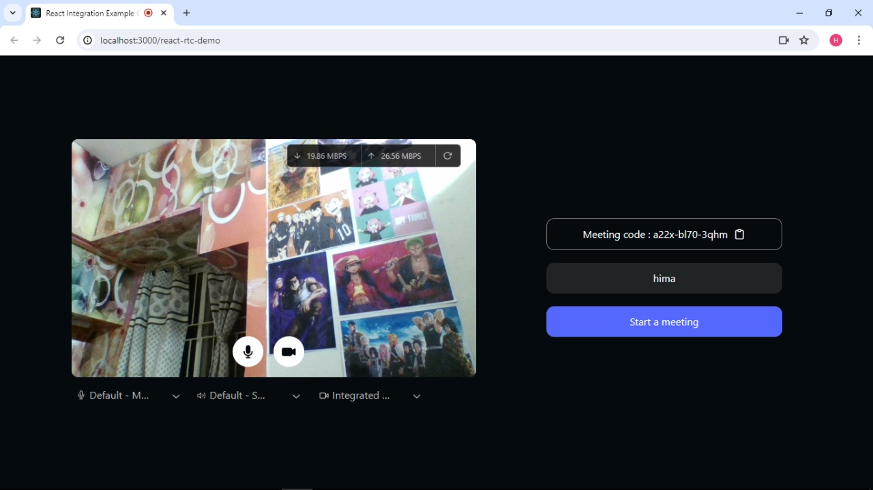

Slide 20
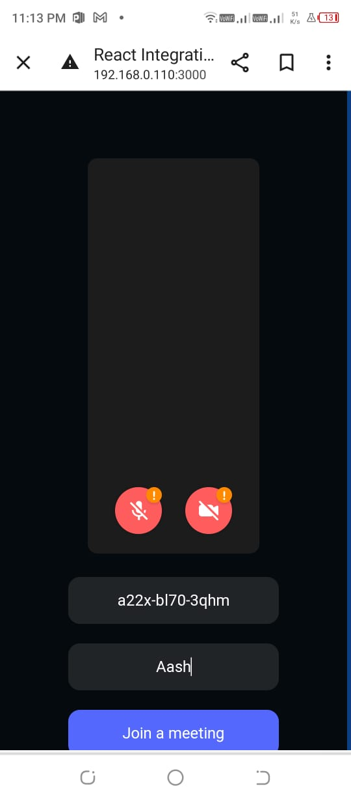

Slide 21
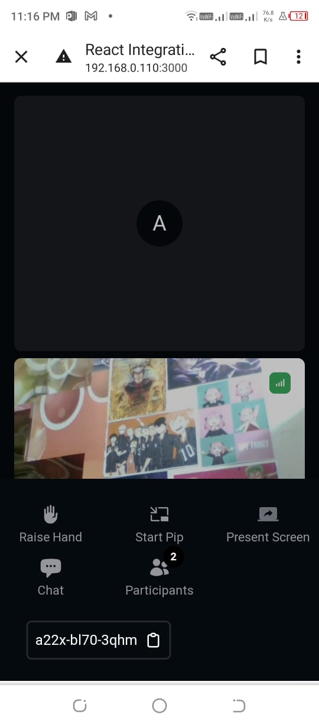

Slide 22
REFERENCES
Al-Qatamin, M. A., & Mnaouer, A. B. (2018). Real-time communication applications: A comprehensive study. Journal of King Saud University - Computer and Information Sciences, 30(4), 507-521.
Singh, A., & Kumar, V. (2019). WebRTC: A revolutionary approach for real-time communication. 2019 IEEE 5th International Conference for Convergence in Technology (I2CT), 1-5.
Grigorik, I. (2013). High-performance browser networking: What every web developer should know about networking and web performance. O'Reilly Media, Inc.
Flanagan, D. (2011). JavaScript: The Definitive Guide. O'Reilly Media, Inc.

Slide 23
THANK YOU

